Slide 1
K Nearest Neighbour
By Pradip Tivhale

Slide 2
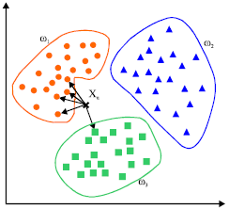
The Big Idea

Slide 3
K Nearest Neighbor
KNN is a typical example of a lazy learner. It is called lazy because it doesn't learn a discriminative function from the training data but memorizes the training dataset instead.

Slide 4
Steps in KNN
1. Choose the number of k and a distance metric.
2. Find the k nearest neighbors of the sample that we want to classify.
3. Assign the class label by majority vote.

Slide 5
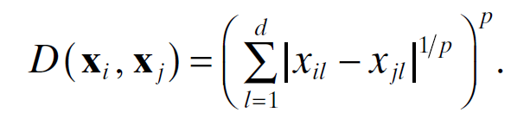
Distance Metric
Euclidean p=1/2
Manhattan P=1

Slide 6
Flow of KNN
Calculate euclidean distance between a test point and all other training points. E.g X1 = {3,3} ,X2 = {6,1}, X3={7,9} ,X4={3,6}
Data points sorted by distance (lowest first)
In a classification, we do majority voting, the most frequent class between the K closest points is the class assigned to our test data point. This works in both binary and multiclass contexts
In a regression setting, we use the average Y value of K nearest training points. So y_pred_i = 1/K ∑y_{training_i}.

Slide 7
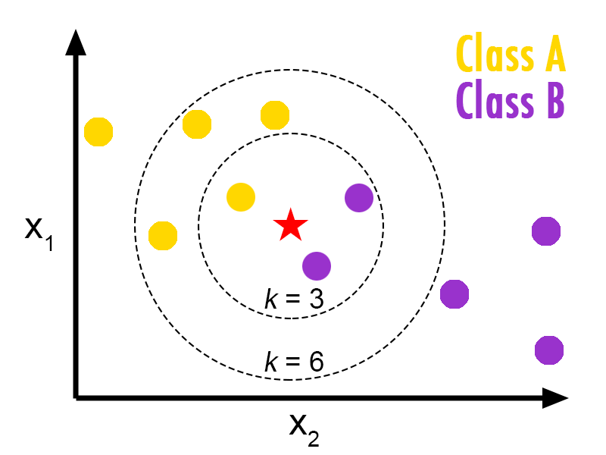
KNN: Classification

Slide 8
Let's look at the pros and cons
Pros:
Very quick and efficient algo (low training time)
Surprisingly effective and easy to interpret
Cons:
Each feature has the same weight, relative importance of features not learned.
Needs to be scaled to work well

Slide 9
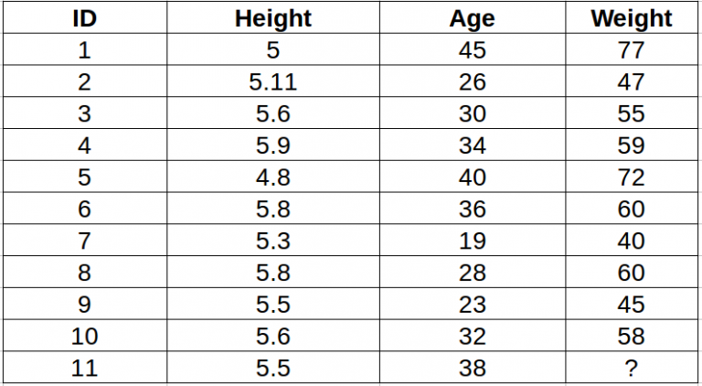

Slide 10
KNN for data retrieval
KNN used for data retrieval.
KNN search has O(N) time complexity for each query where N= Number of data points. For KNN with K neighbor search, the time complexity will be O(N*K) .just imagine what happen millions of datapoint and thousand of query.
Any efficient solution? KD Tree
KD Tree is one such algorithm which uses a mixture of Decision trees and KNN to calculate the nearest neighbour(s).

Slide 11
KD Tree: K-dimensional tree
Binary x,y… compare
(3, 6), (17, 15), (13, 15), (6, 12), (9, 1), (2, 7), (10, 19)

Slide 12
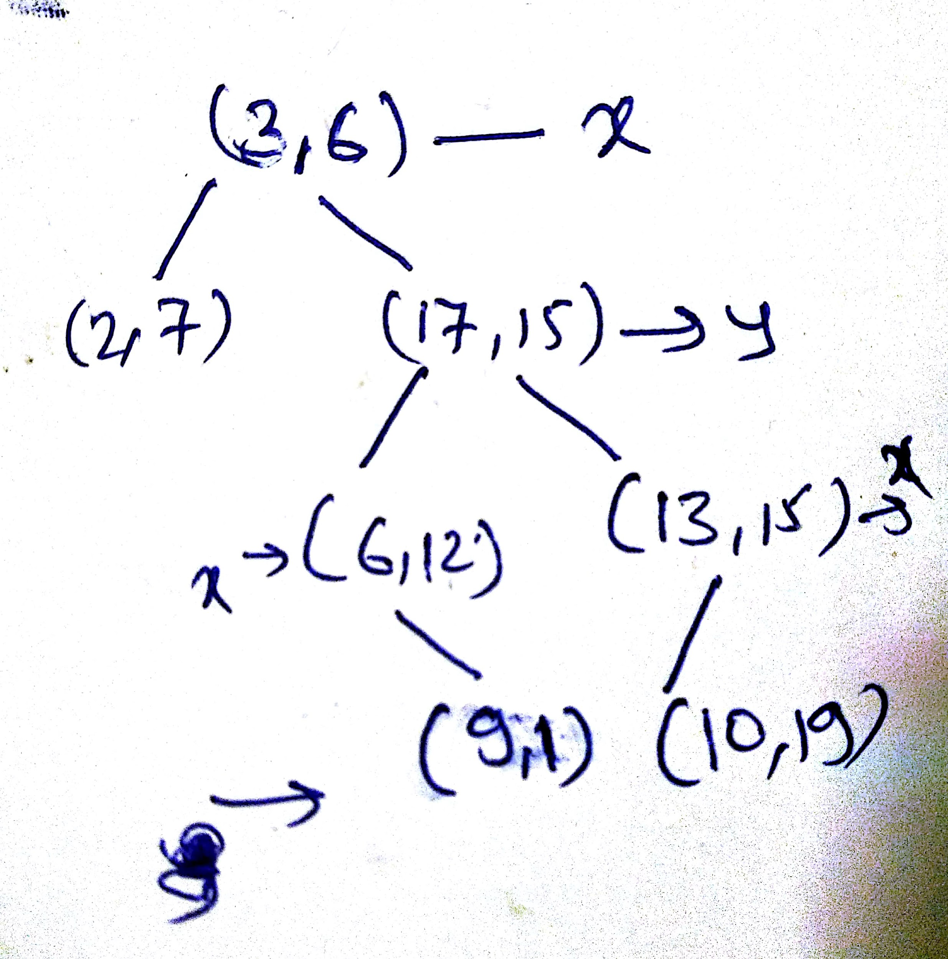

Slide 13
Assignment
Implement euclidean and manhattan distance function
Calculate k value for knn

